Slide 1

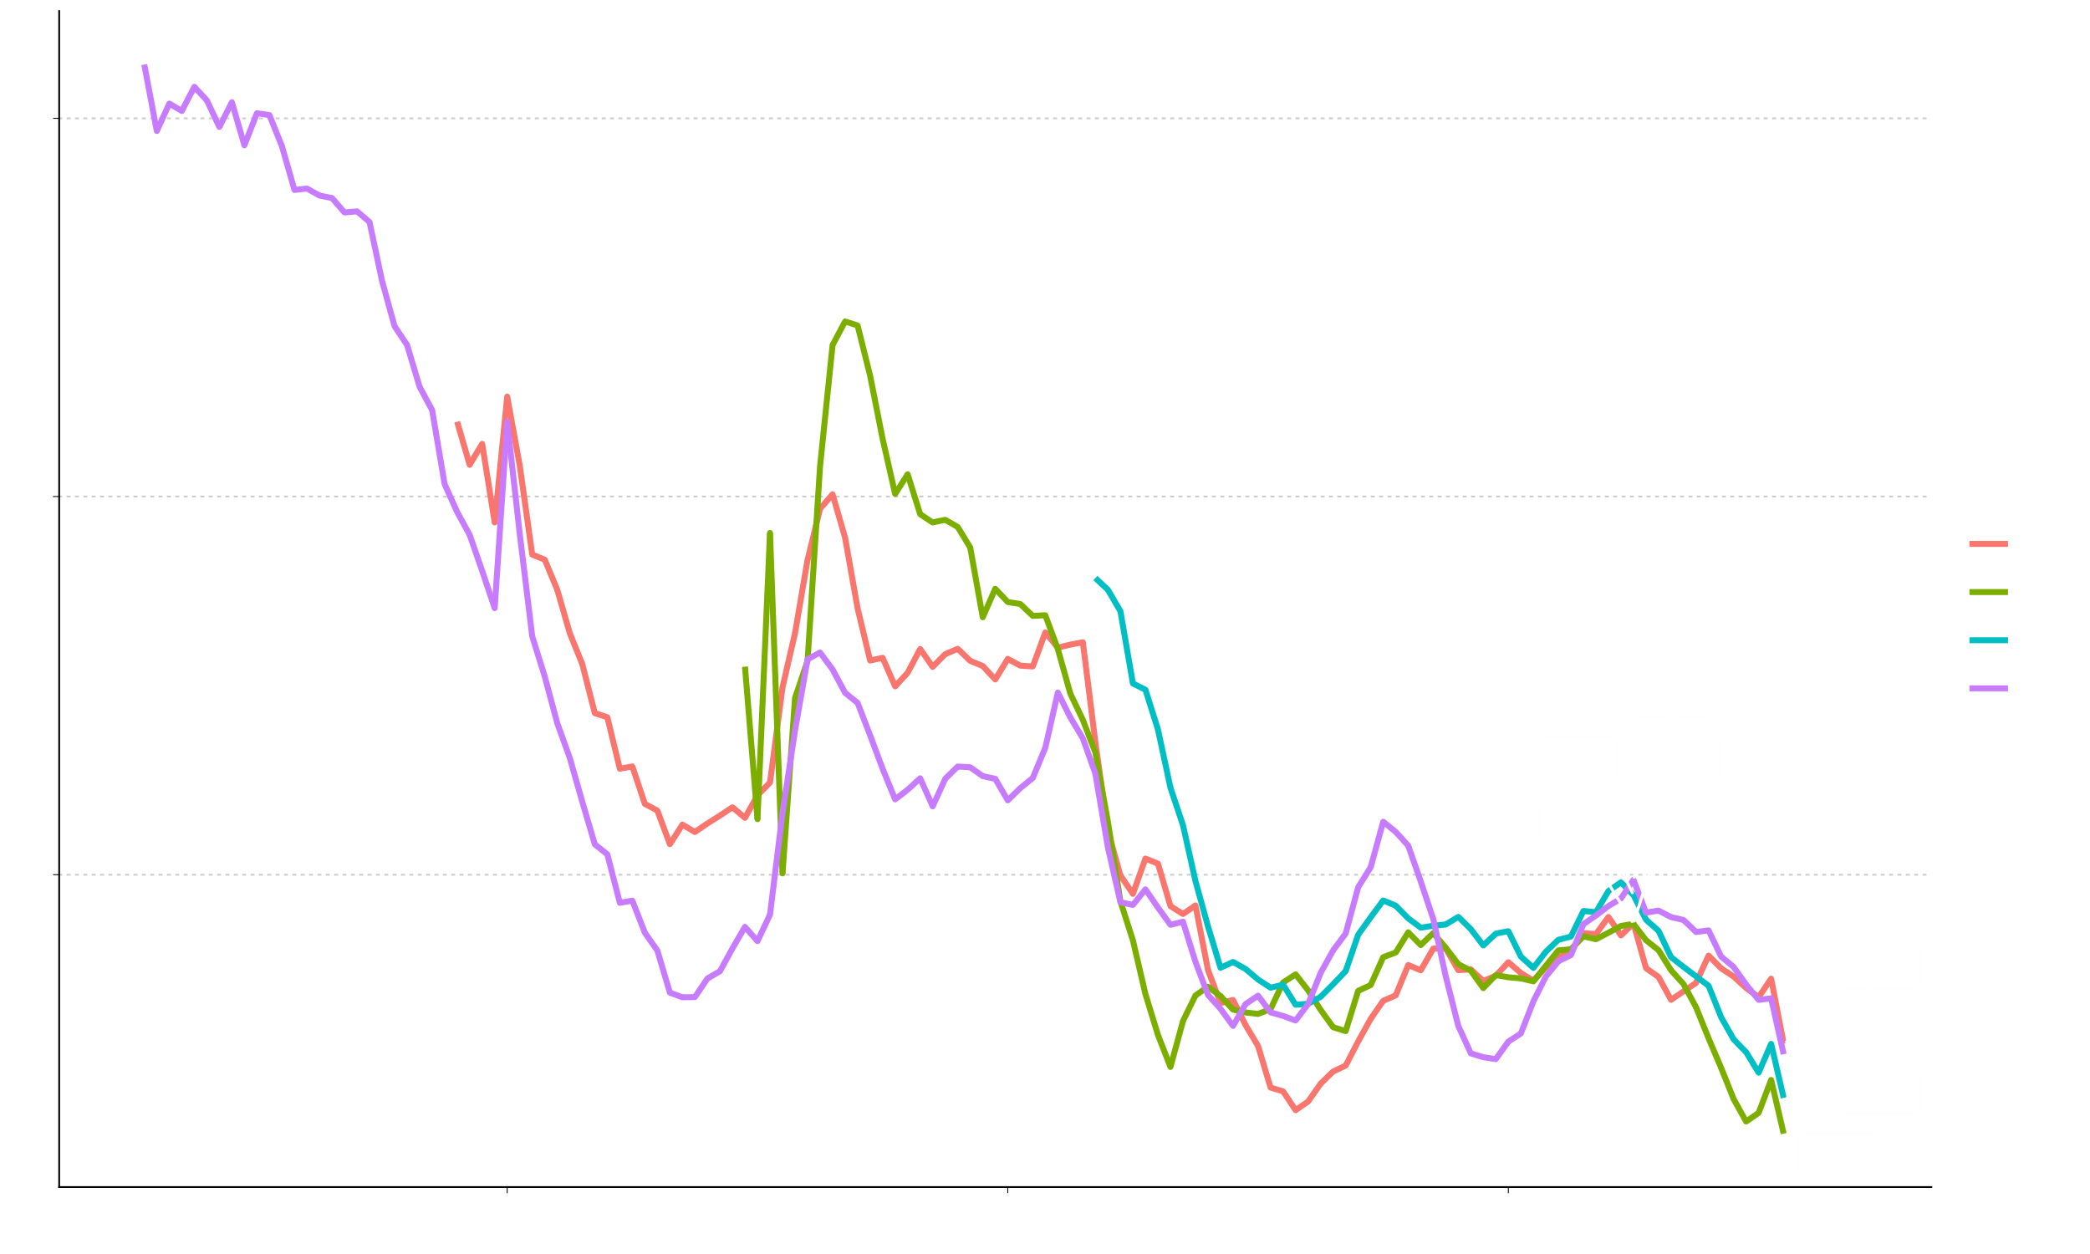
Empirical Prediction Intervals for Forecasts of Nordic Fertility Preliminary Results of Work in Progress
Ricarda Duerst^{1,2}, Julia Hellstrand¹, Jonas Schöley², Mikko Myrskylä^{1,2}
¹ University of Helsinki, FLUX, MaxHel Center ² Max Planck Institute for Demographic Research

Slide 2
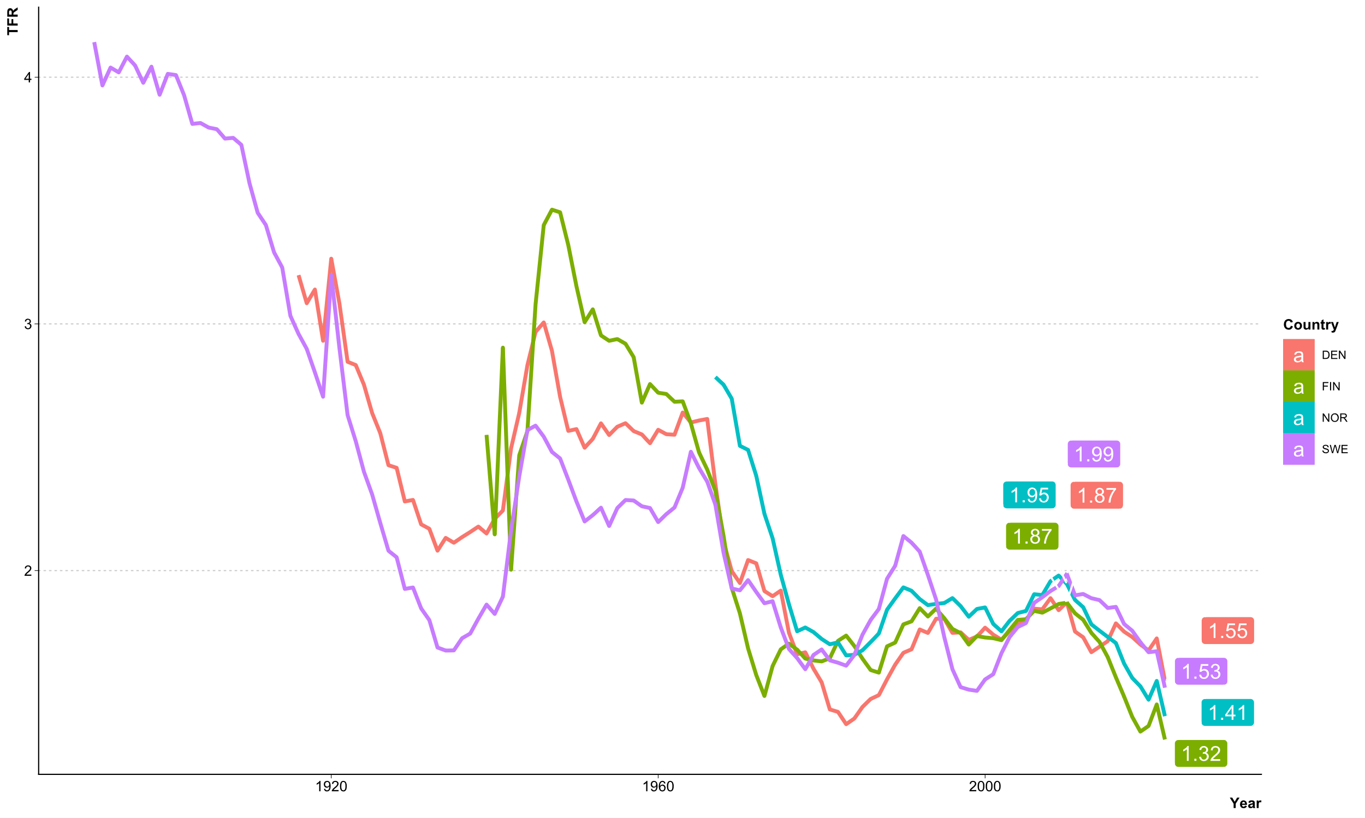
Fertility development in the Nordic Countries
2010
2022

Slide 3
Fertility development in the Nordic Countries
What is needed?
Forecasts of Nordic Fertility
With sensible prediction intervals
What do we have?
A variety of forecast models of different types
With model-based prediction intervals that are usually too narrow

Slide 4
Research Plan
TFR forecasts with empirical prediction intervals
Up to 2050
Quantification of distribution of forecast errors
For forecasts based on: extrapolative models and scenario-based models
Comparison of prediction intervals
Model-based PIs, empirical PIs based on cross-validation and empirical PIs based on expert forecasts
For: Sweden, Denmark, Norway, and Finland

Slide 5
Forecast Models

Slide 6

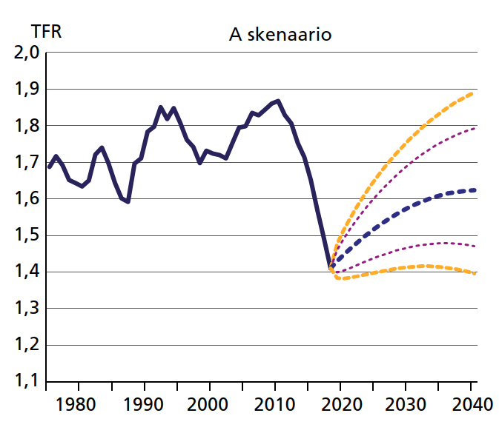
Postponement Scenario (PPS)
Fertility and its determinants in the coming decades in Finland
Nisén, Hellstrand, Martikainen, Myrskylä, 2020:
Hedelmällisyys ja siihen vaikuttavat tekijät Suomessa lähivuosikymmeninä.
Yhteiskuntapolitiikka. https://urn.fi/URN:NBN:fi-fe2020091669848
Assumption
Fertility postponement will continue, but gradually slow down and eventually stop → tempo-adjusted TFR and TFR will converge by the end of the forecast horizon

Slide 7
Lee-Carter Model (LC)
Lee, 1993:
Modeling and forecasting the time series of U.S. fertility: age distribution, range, and ultimate level.
International Journal of Forecasting. https://www.sciencedirect.com/science/article/pii/0169207093900047
Method
Simple extrapolation model based on age-specific fertility rates
A demographic classic, equivalent to the Lee-Carter model for mortality (Lee, Carter, 1992)
As reference Last observed TFR is fixed
Naive Forecast

Slide 8
Empirical Prediction Intervals

Slide 9
The principle of empirical prediction intervals
A forecast is only as precise as similar forecasts in the past turned out to be.
Calibration
Validation
Application

Slide 10
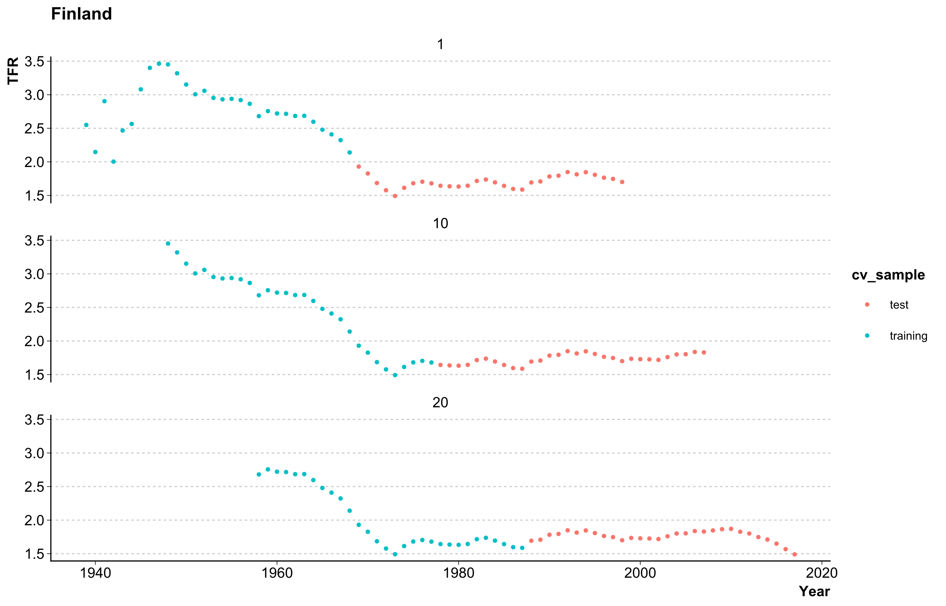
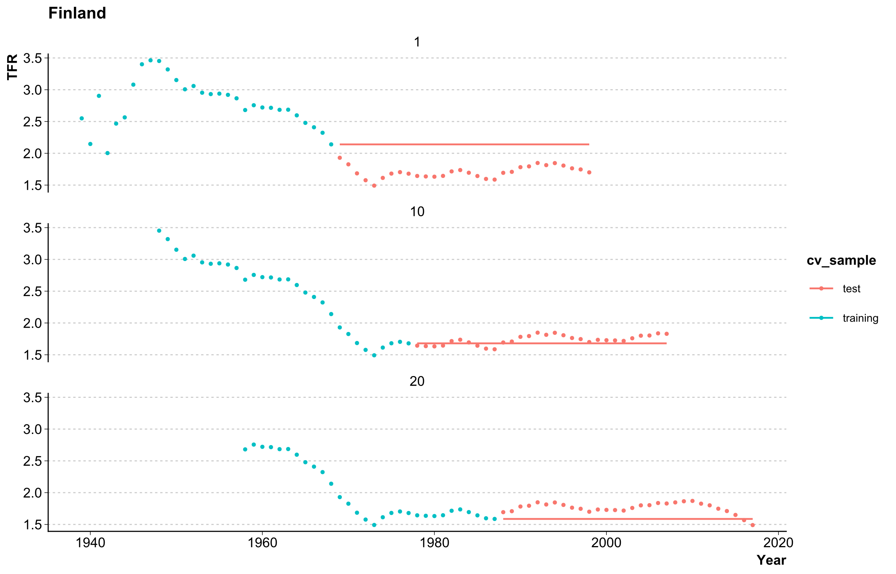

empirical prediction intervals from cross-validation
Country | Training/ Test Length | Nr. of Series | Calibration Years
Finland | 30/30 | 25 | 1939 - 2017
Sweden | 30/30 | 73 | 1891 - 2017
Denmark | 30/30 | 48 | 1916 - 2017
Norway | 30/15 | 12 | 1967 - 2017
Naive forecast (for demonstration purposes only)
Validation Years: 2018 – 2022
Application Years: 2023 – 2050

Slide 11
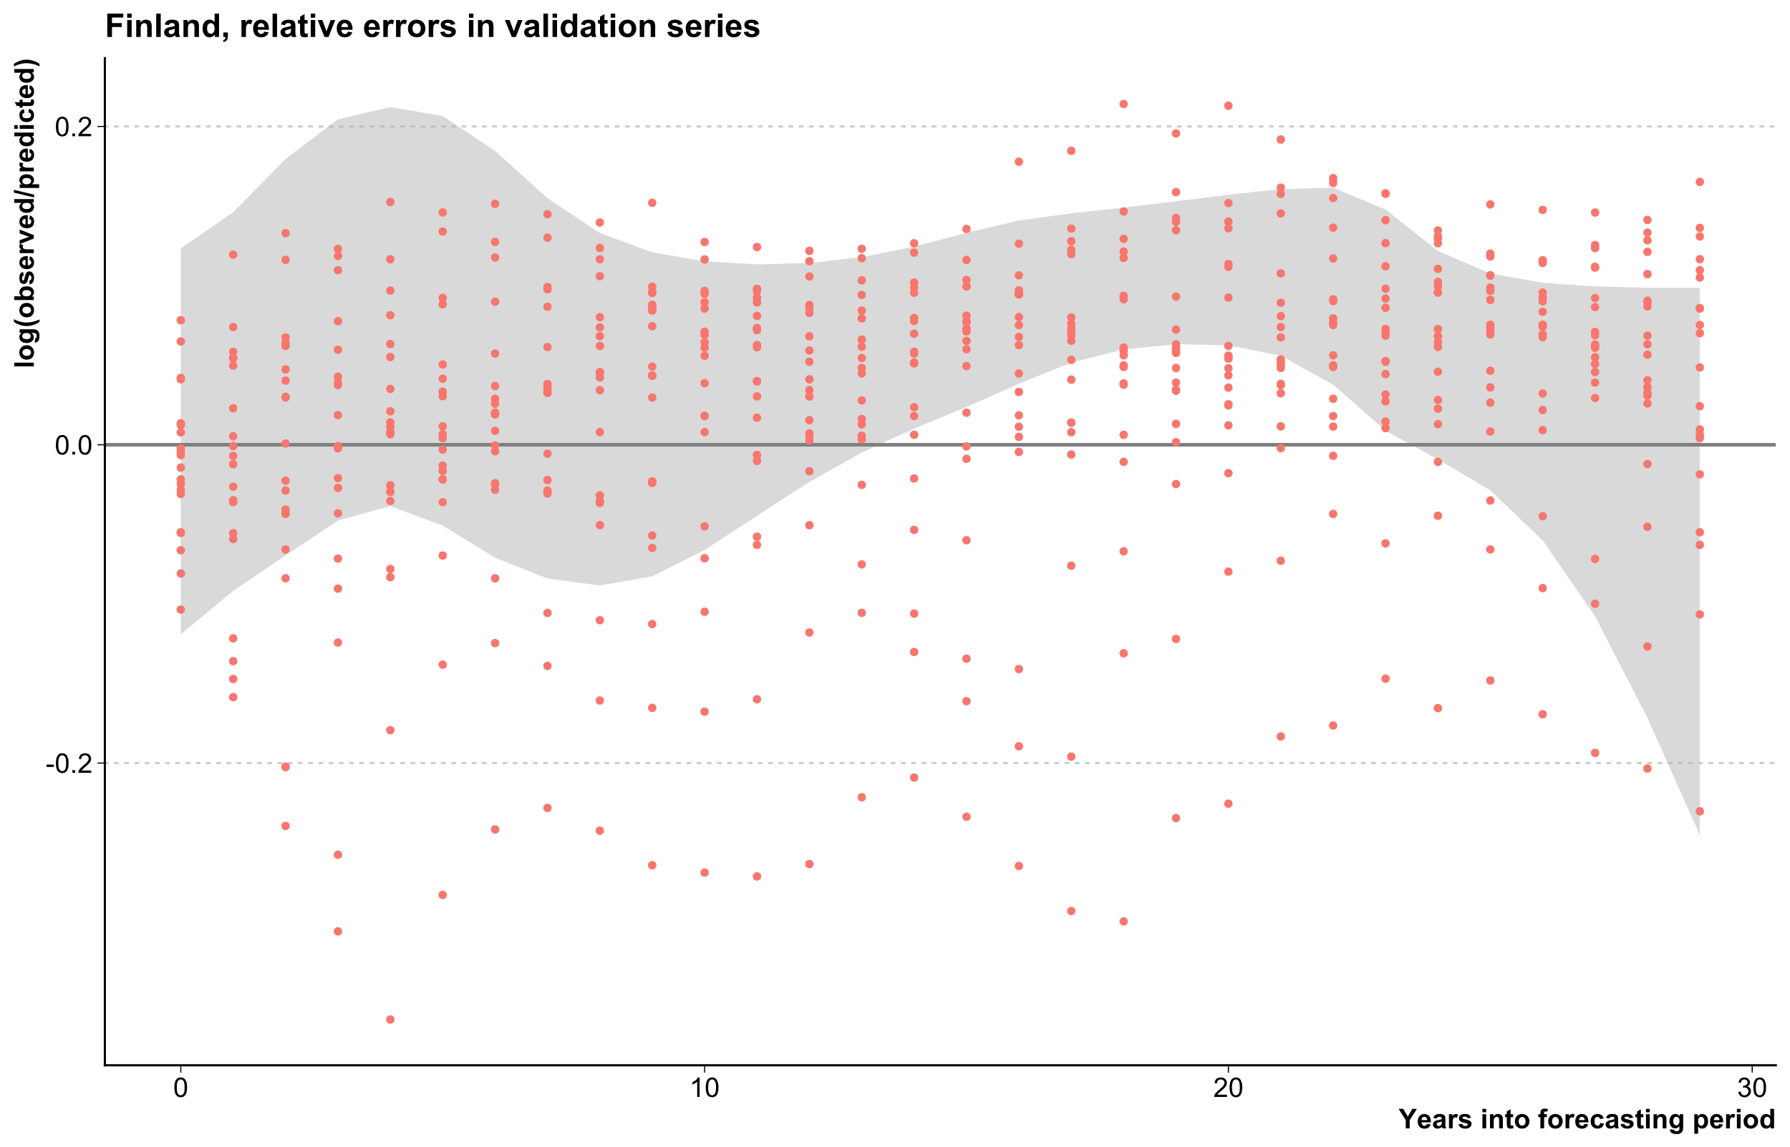

empirical prediction intervals from cross-validation
Naive forecast (for demonstration purposes only)
Forecast Error
Error distribution models
Skew-normal distribution
Raw quantiles

Slide 12
Empirical Prediction intervals For Scenarios
Country | Calibration Years
Finland | 1969 - 2017
Sweden | 1921 - 2017
Denmark | 1946 - 2017
Norway | 1997 - 2017
Fertility postponenment began in the 1970s is the Nordics
Consensus among researchers in the past on slowing down of postponement and ist effects
Application of scenario-based method to fitting time periods

Slide 13
Empirical Prediction intervals From Publications
Keilman & Pham, 2004: Time Series Based Errors and Empirical Errors in Fertility Forecasts in the Nordic Countries. International Statistical Review. https://doi.org/10.1111/j.1751-5823.2004.tb00220.x
Estimation of forecast error distribution from real historical forecasts

Slide 14
Preliminary Results

Slide 15
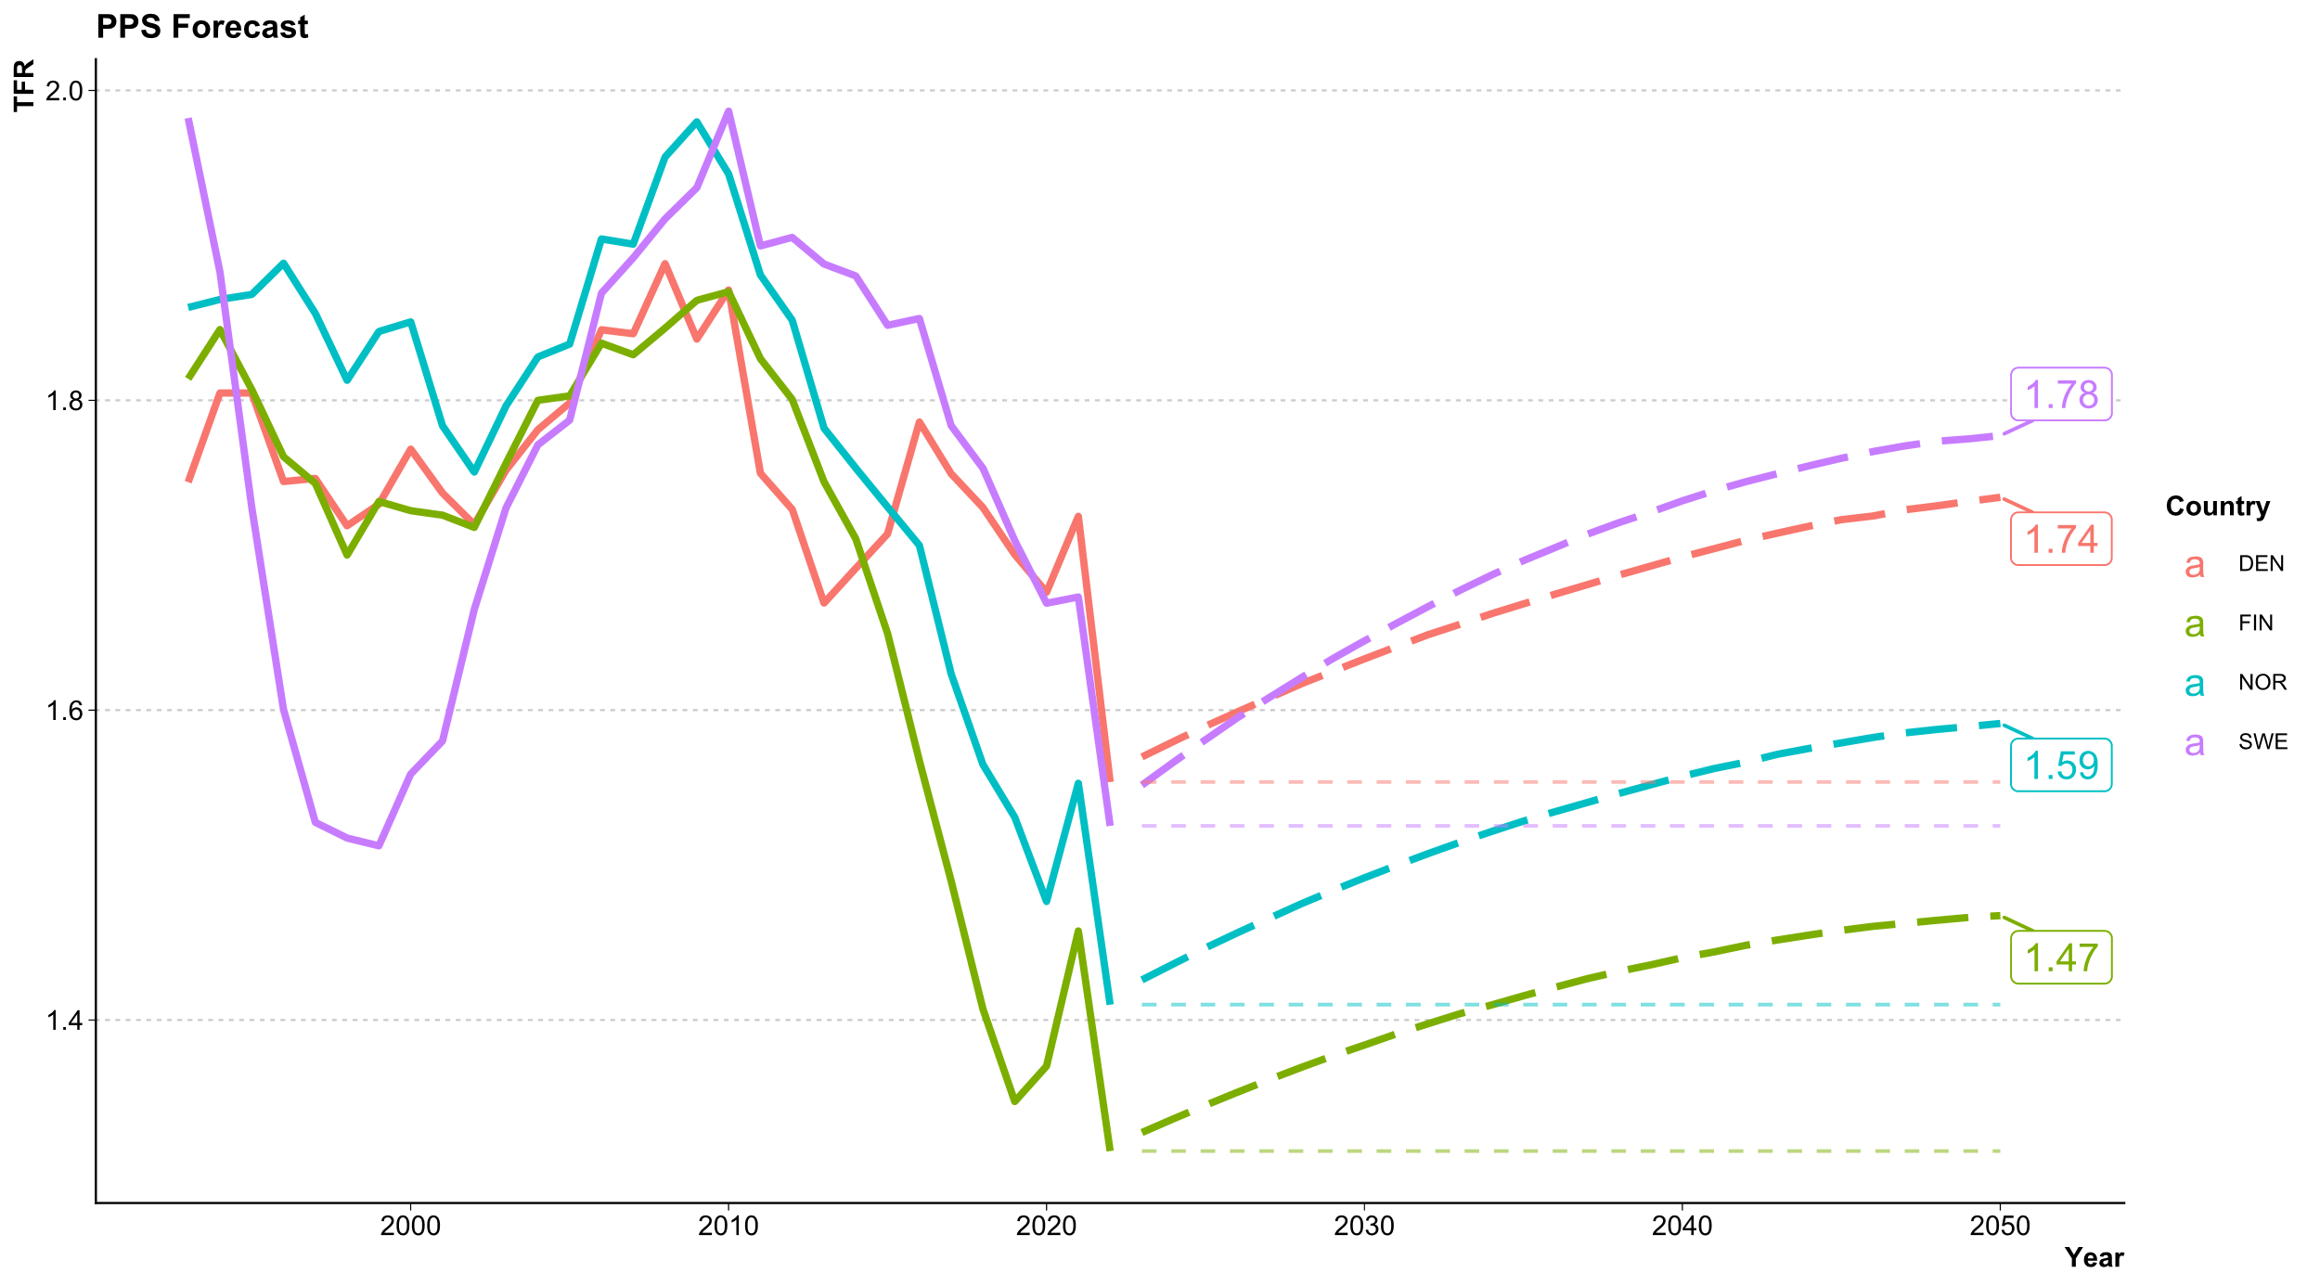

Slide 16
Lee carter forecast all countries

Slide 17
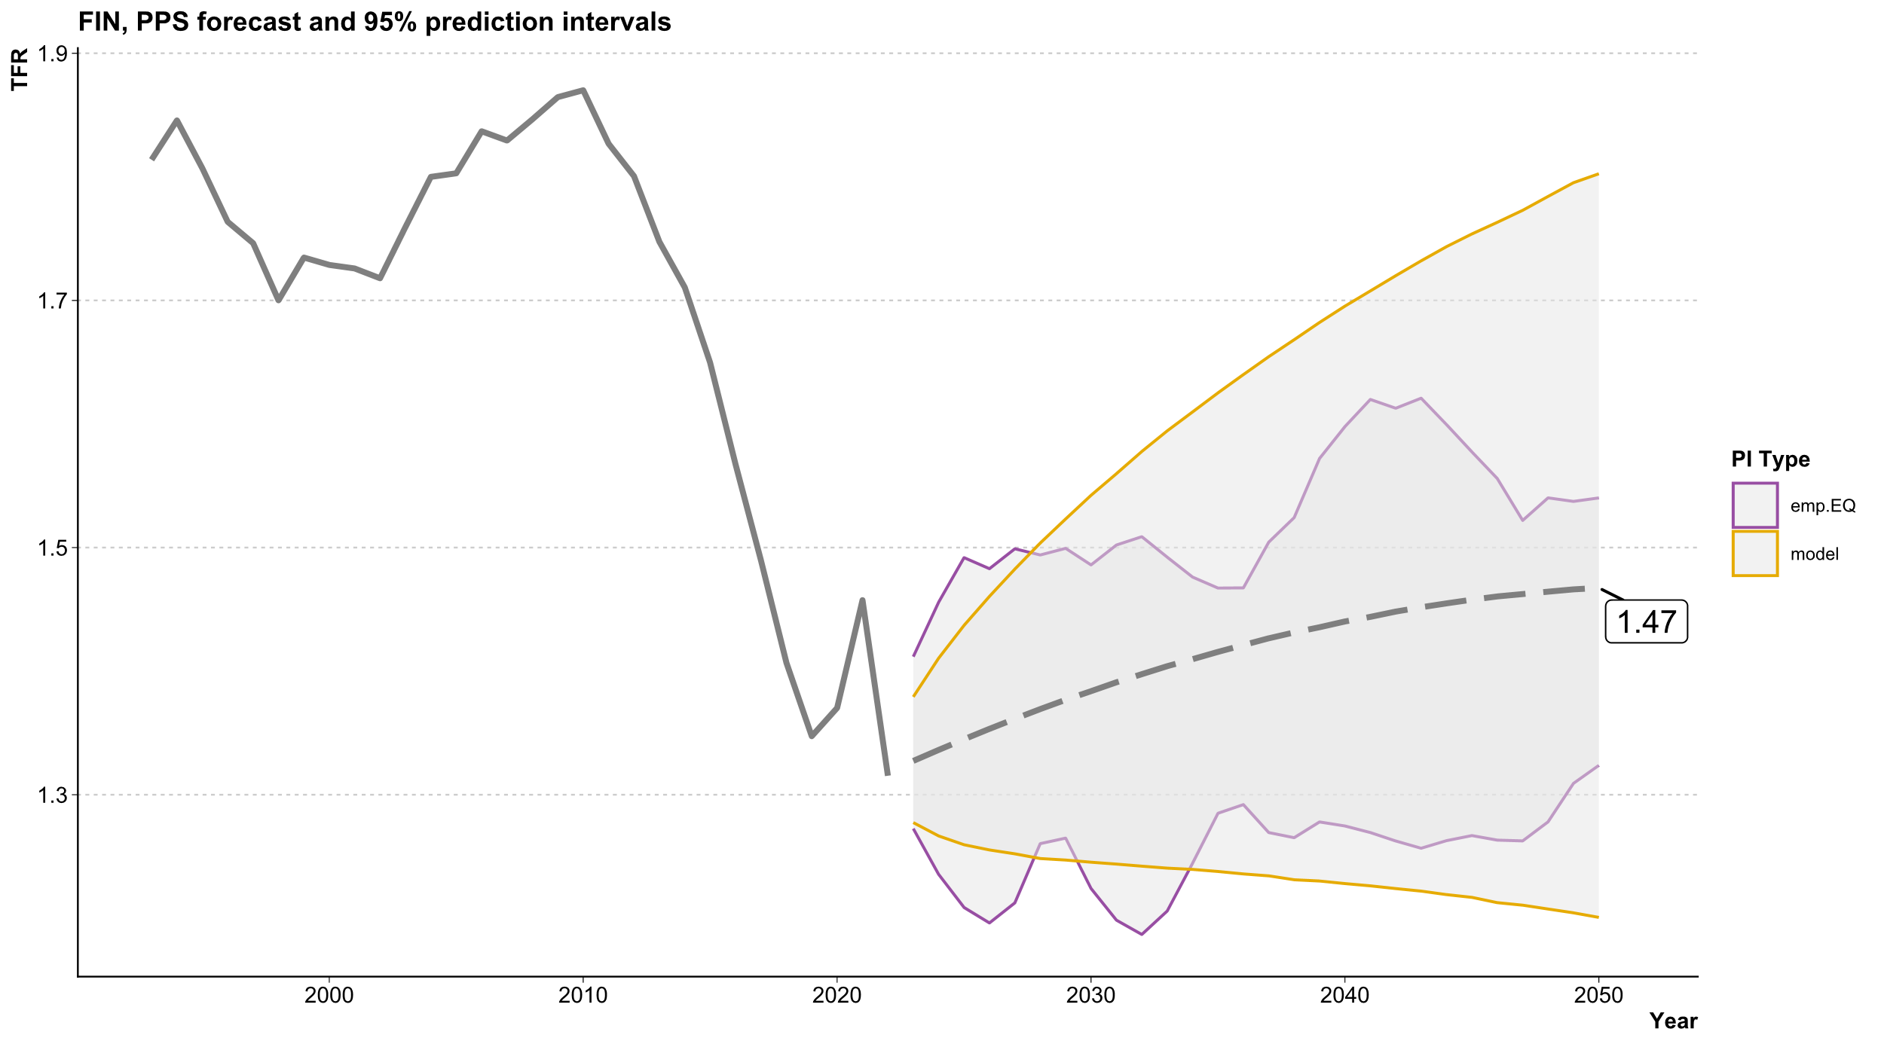
1.80
1.54
1.32
1.20

Slide 18

Thank You for your Attention!
Ricarda Duerst
University of Helsinki MPIDR
duerst@demogr.mpg.de
Julia Hellstrand
University of Helsinki
julia.hellstrand@helsinki.fi
Jessica Nisén
University of Turku University of Helsinki MPIDR
jessica.nisen@utu.fi
Jonas Schöley
MPIDR
schoeley@demogr.mpg.de
Mikko Myrskylä
University of Helsinki MPIDR
myrskylä@demogr.mpg.de

